Slide 1
Alkalinity: to clarify
1) Concentration of excess bases over acids
Alk = [HCO₃⁻] + 2[CO₃²⁻] + [B(OH)₄⁻] + [OH⁻] - [H⁺]
2) Charge balance of conservative cations and anions
Alk = [Na⁺] + [K⁺] + 2[Mg²⁺] + 2[Ca²⁺] + minor cations
– [Cl⁻] – 2[SO₄²⁻] – [Br⁻] – minor anions
Ca²⁺ + CO₃²⁻ ←→ CaCO₃

Slide 2
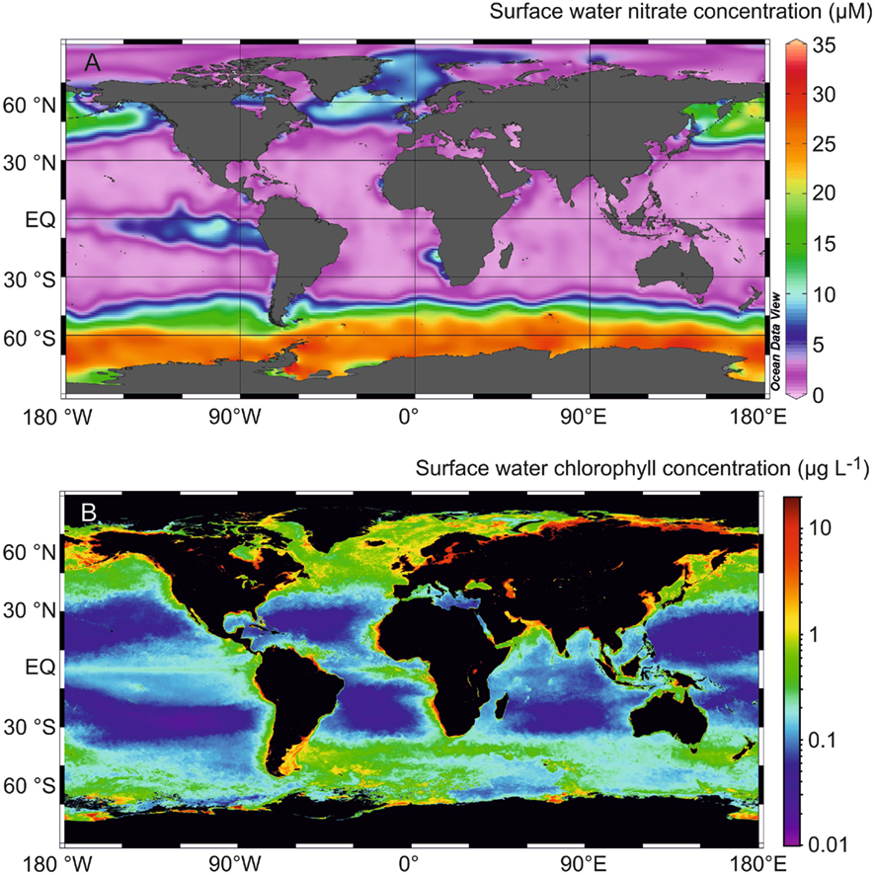
Nutrients and productivity I
30 May
2017

Slide 3
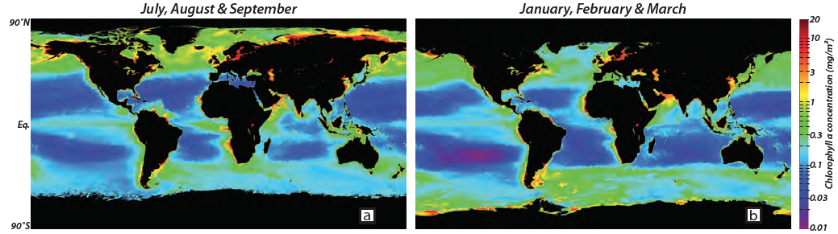
Global ocean productivity
Northern hemisphere summer
Southern hemisphere summer
Satellite-derived chlorophyll-a (mg/m³)
What controls the observed distribution of productivity?
oceancolor.gsfc.nasa.gov; Sigman and Hain, 2012

Slide 4
Global ocean productivity: definitions
Gross primary production (GPP): total rate of organic carbon production from CO₂ by autotrophs (photosynthesis)
Respiration (R): energy-yielding oxidation of organic carbon back to CO₂
Net primary production (NPP): GPP – autotrophic R;
Net rate of biomass production by phytoplankton
Net ecosystem/community production (NEP/NCP): GPP – ecosystem R; organic matter that sinks out of the euphotic zone. Quantifies the removal of atmospheric CO₂ by the upper ocean ecosystem. Equivalent to export production.

Slide 5
Photosynthesis
6CO₂ + 6H₂O C₆H₁₂O₆ + 6 O₂
C₆H₁₂O₆ + 6O₂ energy + 6CO₂ + 6H₂O
Respiration

Slide 6
Photosynthesis
106CO₂ + 16HNO₃ + H₃PO₄ + 78H₂O C₁₀₆H₁₇₅O₄₂N₁₆P + 150O₂
C₁₀₆H₁₇₅O₄₂N₁₆P + 150O₂ 106CO₂ + 16HNO₃ + H₃PO₄ + 78H₂O
Remineralization

Slide 7
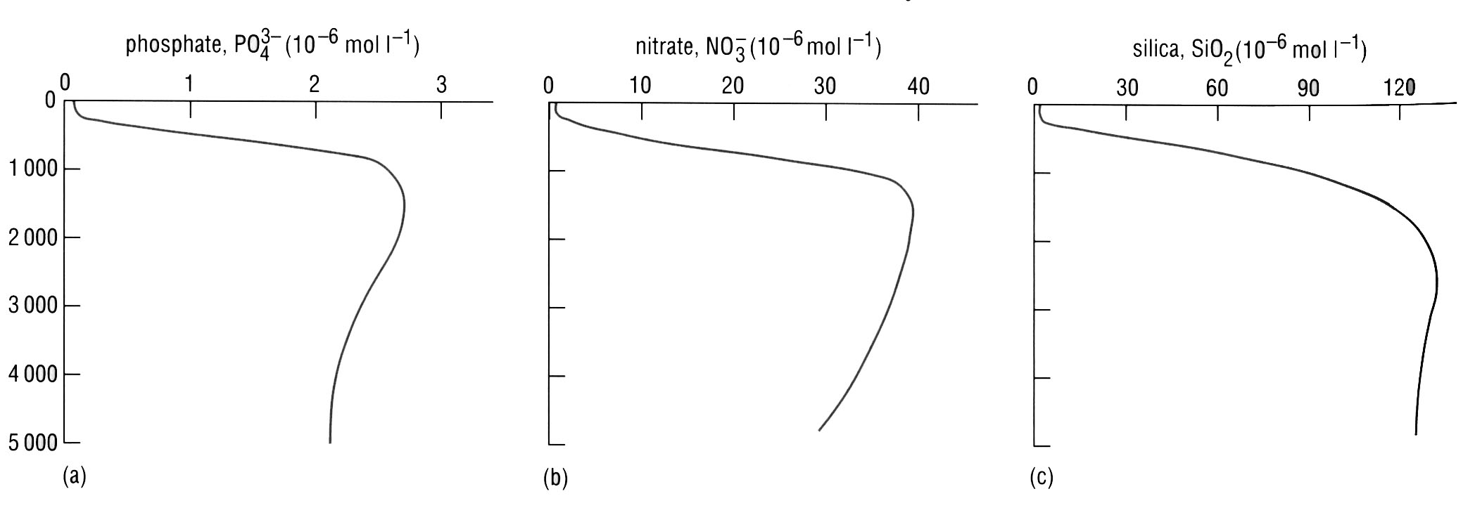
Phytoplankton require nutrients
Average composition of phytoplankton biomass
(C₁₀₆N₁₆Si₁₆P₁S_{1.3}K_{1.7}Mg_{0.56}Ca_{0.5})₁₀₀₀Sr₅Fe_{7.5}Zn_{0.8}Cu_{0.38}Co_{0.19}Cd_{0.21}Mo_{0.03}
Macronutrients Micronutrients
Nitrogen (NO₃⁻, NO₂⁻, NH₄⁺) Trace metals
Phosphorus (PO₄³⁻, organic P) Vitamins
Silica
Phosphate
Nitrate
Silicate
0-3 μmol/L
0-40 μmol/L
0-120 μmol/L
Ho et al. 2003

Slide 8
Phytoplankton require nutrients
Average composition of phytoplankton biomass
(C₁₀₆N₁₆Si₁₆P₁S_{1.3}K_{1.7}Mg_{0.56}Ca_{0.5})₁₀₀₀Sr₅Fe_{7.5}Zn_{0.8}Cu_{0.38}Co_{0.19}Cd_{0.21}Mo_{0.03}
Macronutrients Micronutrients
Nitrogen (NO₃⁻, NO₂⁻, NH₄⁺) Trace metals
Phosphorus (PO₄³⁻, organic P) Vitamins
Silica
Phosphate
Nitrate
Silicate
0-3 μmol/L
0-40 μmol/L
0-120 μmol/L
Ho et al. 2003

Slide 9
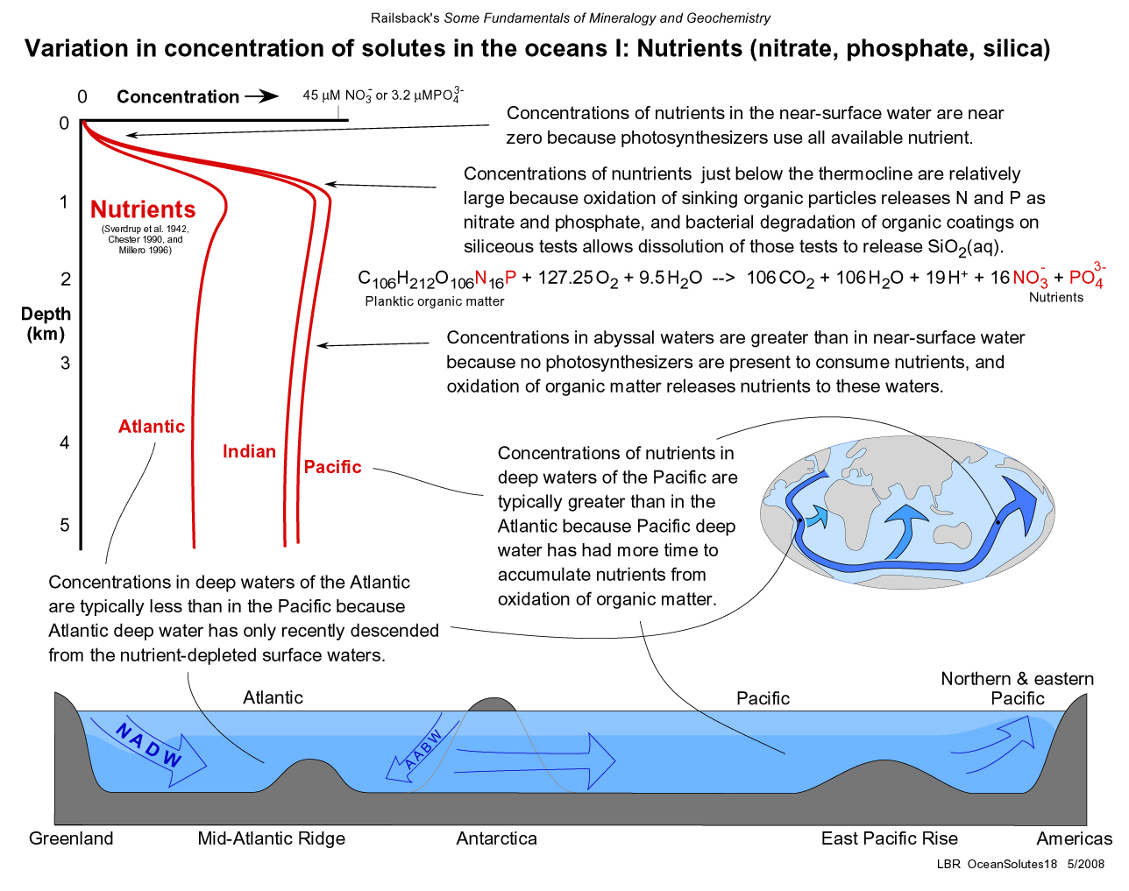
“Nutrient-like” distributions
Photosynthesis = nutrient uptake
Oxidation of sinking organic matter releases N and P as nitrate and phosphate; dissolution of silicate
(remineralization)
PO₄³⁻
NO₃⁻
SiO₂
Abyssal waters: no photosynthesis and slow oxidation of organic matter to nutrients

Slide 10
“Nutrient-like” distributions
Photosynthesis = nutrient uptake
Oxidation of sinking organic matter releases N and P as nitrate and phosphate; dissolution of silicate (remineralization)
PO₄³⁻
NO₃⁻
SiO₂
Abyssal waters: no photosynthesis and slow oxidation of organic matter to nutrients
Atlantic
Pacific
N and E Pacific

Slide 11
A few definitions
Nutrient limitation: Low nutrient concentrations can limit the growth rate of individual cells, and the total available amount of a nutrient can also set an upper bound on the amount of new biomass that can be formed (the yield)
Co-limitation: conditions where two (or more) nutrients have simultaneously been drawn down to levels where addition of both is required to stimulate growth
Residence time: average time a nutrient spends in the ocean between entering it and being removed from it. Calculated as reservoir size divided by the rate of input or output. The shorter the residence time, the faster its reservoir size can change due to an input/output imbalance

Slide 12
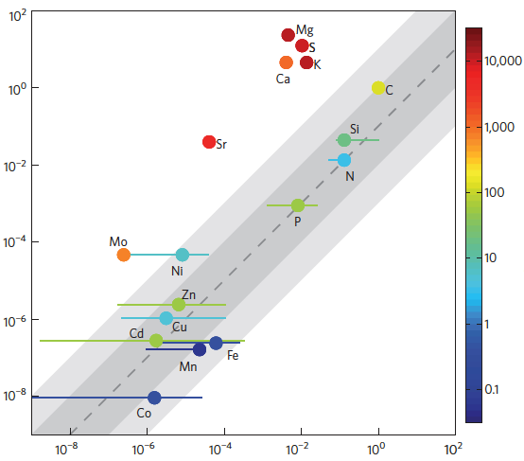
Nutrient limitation
seawater > biomass
nutrient dissolved in seawater (normalized to C)
residence
time (years)
seawater < biomass
Nutrient in phytoplankton biomass (normalized to C)
Moore et al. 2013

